Slide 1
Advanced BLAST BIFX-550
S. Ravichandran, Ph.D. Biology,
Hood College, Frederick, MD 21701

Slide 2
Goals
Define Position Specific Scoring Matrix (PSSM)
How PSI-BLAST and DELTA-BLAST can improve the searches?
Advantages of HMM
How to improve the sensitivity of DNA based searches?
How NGS reads are aligned to a reference Genome?

Slide 3
Beyond BLAST
We already saw with RBP4 that the basic BLAST is not going to be useful
Here are more examples:
Myoglobin is homologous to alpha and beta globins (vertebrate members of globin family)
Let us use beta globin NP_000509.1 as query and do BLASTP (db: nr or RefSeq)
Do we see the myoglobin?

Slide 4
Beyond BLAST
If you want to search and compare a long query (> 20K ) against a DB?
Ex. hChr2 (60 M) vs mChr2 (~ M )
Traditional blast will not work
Why?
Target frequencies (some region more conserved and some less conserved)

Slide 5
Beyond BLAST
NGS has several Millions of short reads (100-400 bp)
Goal is to align them to RefSeq
What is the problem here?
400 bp thousands of them
Aligned to a 3 Billion sequence Reference

Slide 6
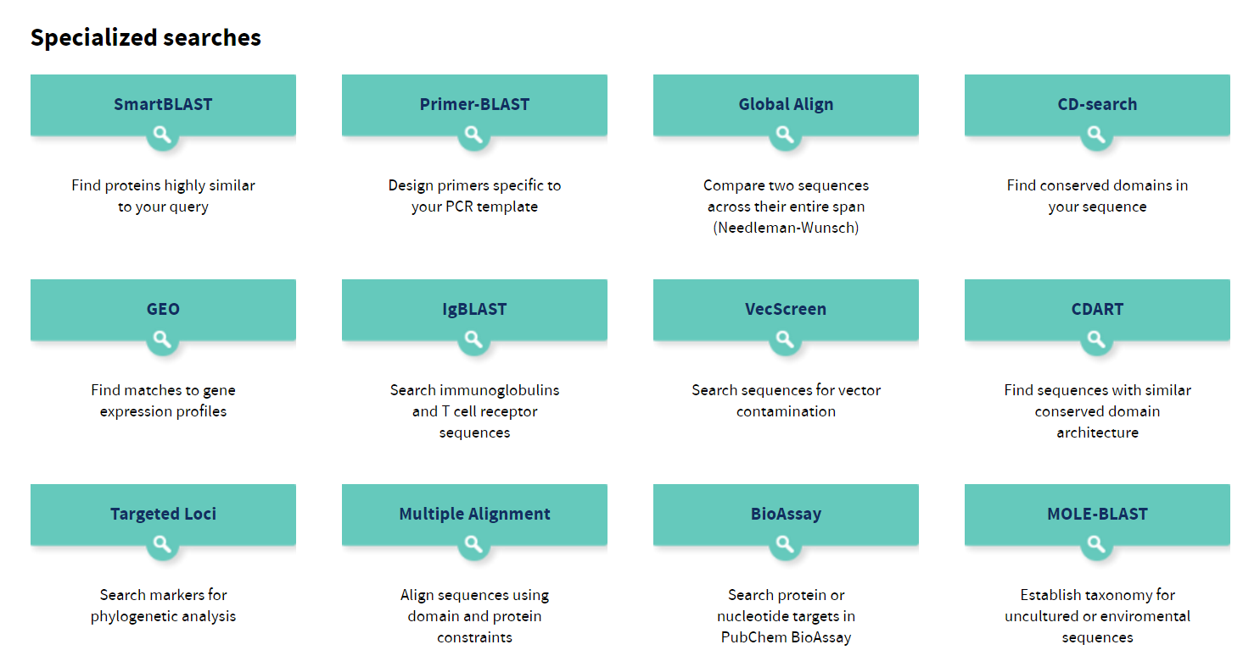
Specialized Searches in NCBI

Slide 7
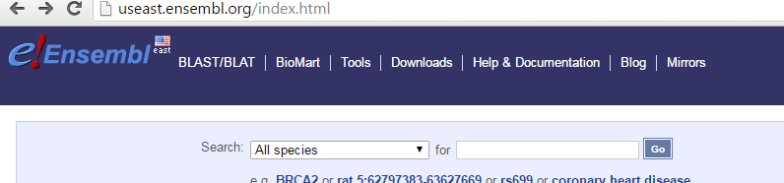
Specialized BLAST
Ensembl BLAST

Slide 8
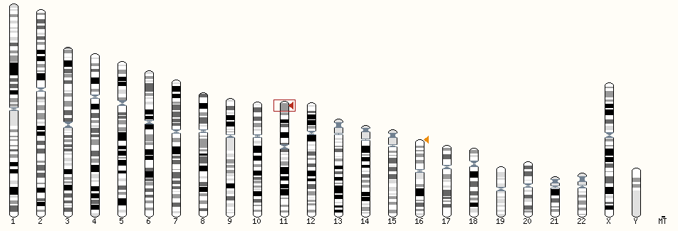
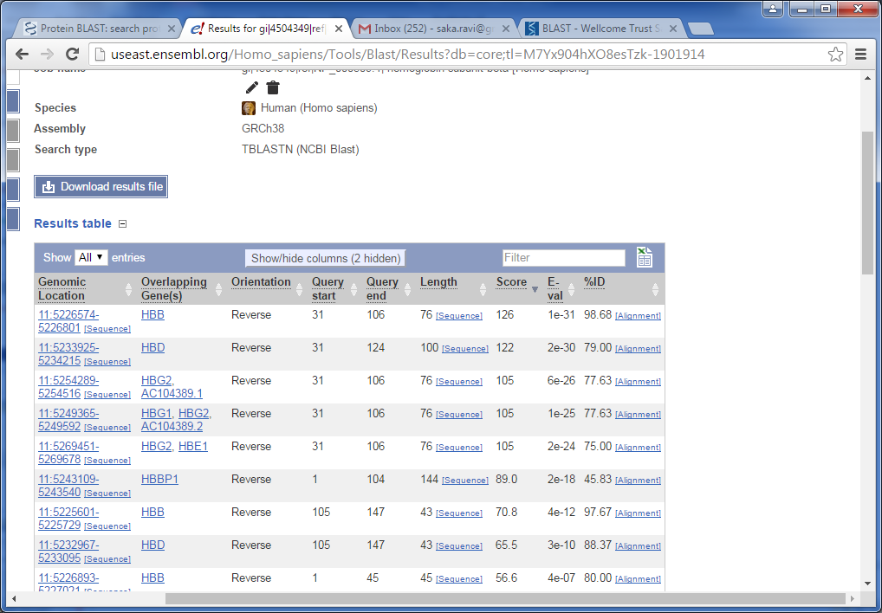
HBB
TBLASTN hHBB

Slide 9
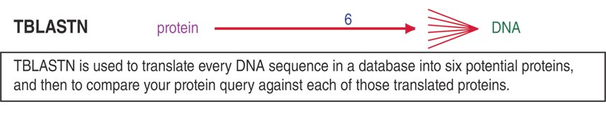
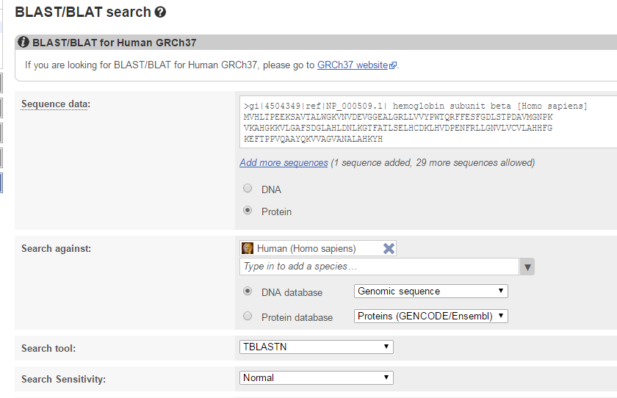
Ensembl BLAST
Fill the NP number and the rest fills in automatically
NOTE THIS SERVICE TAKES TIME

Slide 10
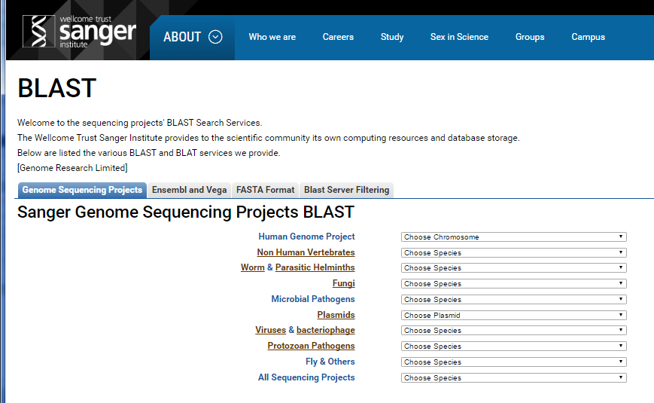
Sanger BLAST Server

Slide 11
Specialized BLAST Servers
WU BLAST 2.0
Strengths: Speed; increased sensititivity Warren Gish WU
European Bioinformatics Institute (EBI) BLAST

Slide 12
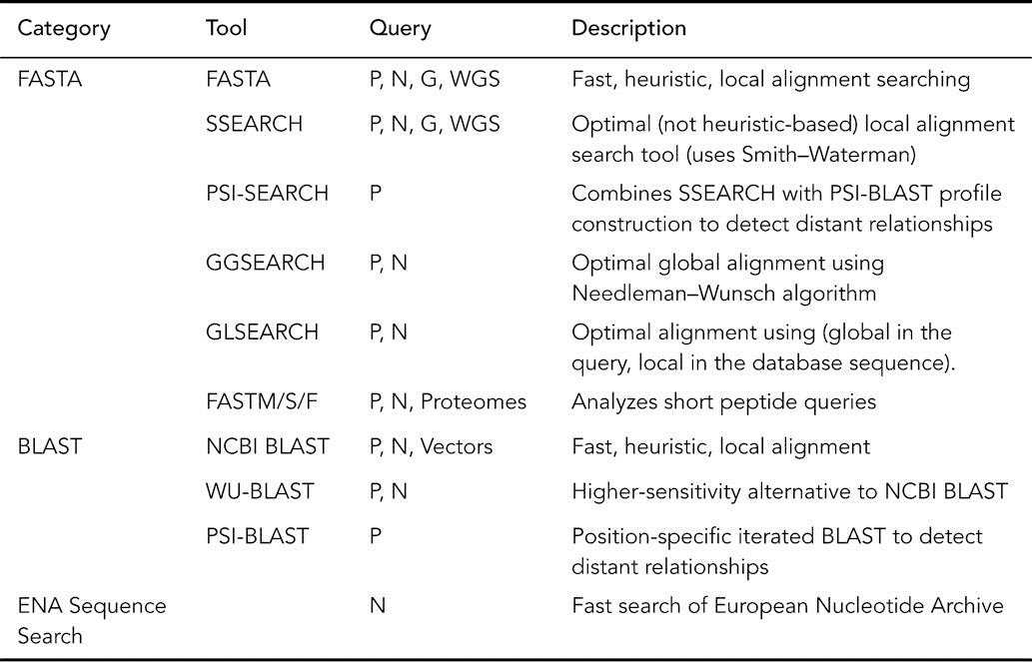
EBI Search Tools

Slide 13
NCBI Specialized BLAST
We will introduce NGS in the next few weeks.
This week we will introduce specialized BLAST using the NGS data
For this we will be using a well-studied genome sequence collection called, NA12878 (sequence collection of an individual)

Slide 14
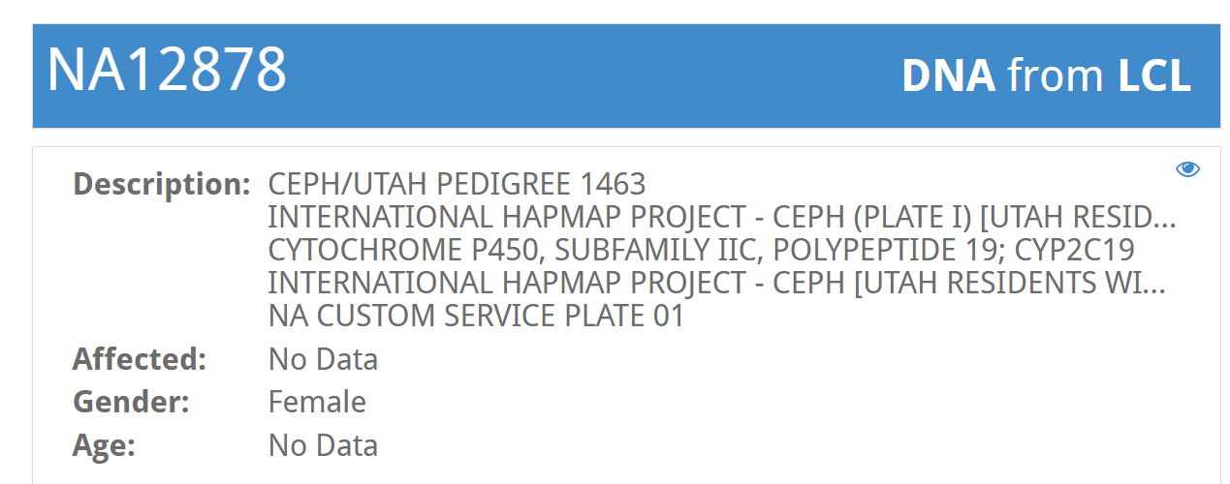
NA12878
Well studied genome (using many sequencing technologies) of an individual
400 entries associated with this entry

Slide 15
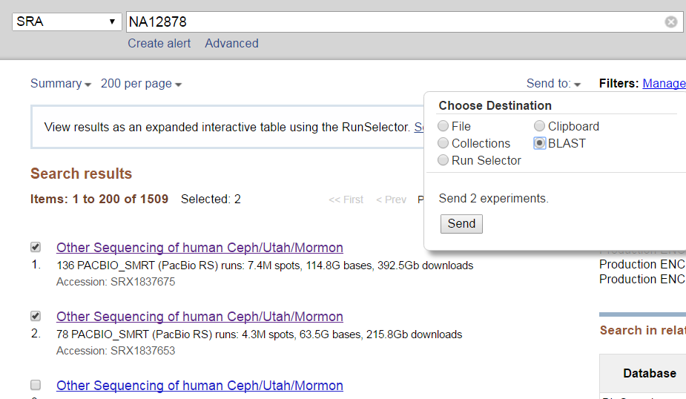
SRA sequence Read Archive makes biological data available to public. The SRA stores raw sequencing and alignment information from High-throughput platforms (PACBIO, Illumina etc.)

Slide 16
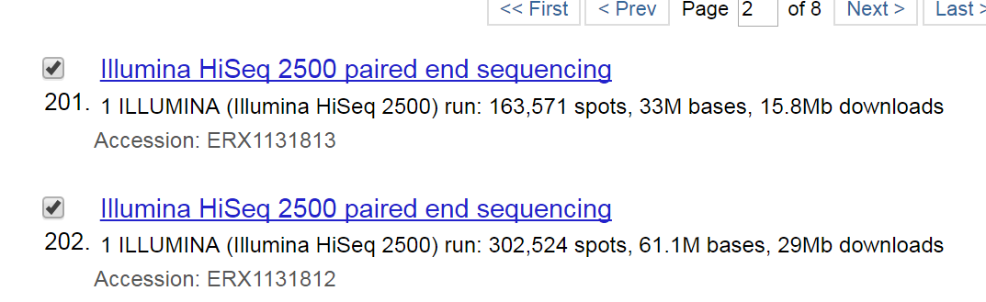
Note that not all SRA experiments are suitable (long reads) for BLAST.
You can also do the following :
NCBI → "ERX1131812"[All Fields] OR "ERX1131813"[All Fields] Send to → BLAST

Slide 17
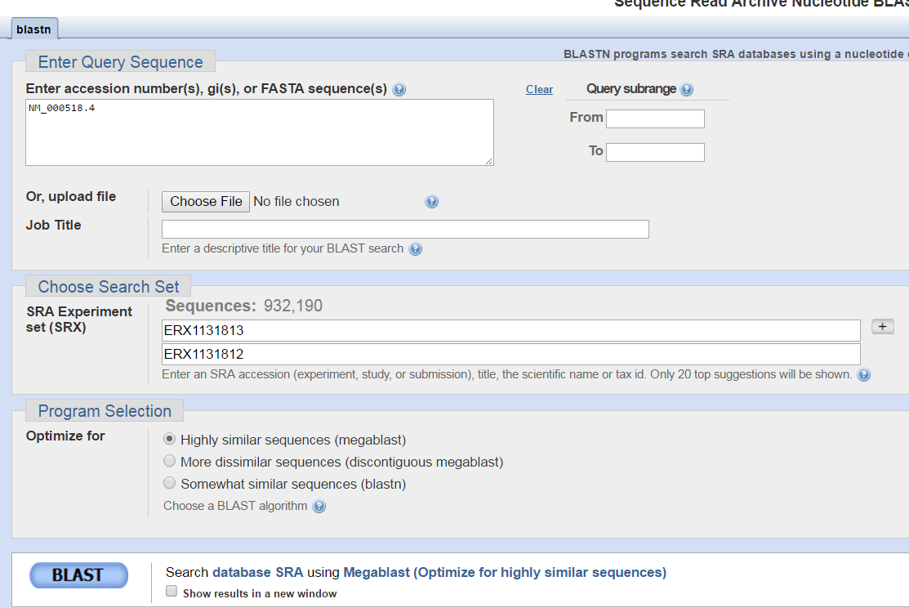
Did BLAST gave any results? Can you guess, why? How to fix the issue?
Use plus to add new SRX entries

Slide 18
PSI-BLAST
Sensitive and specialized form of BLAST
Useful to find distantly related sequences
PSI-BLAST steps
Normal BLAST uses the matrices that was created and available (BLOSUM62, PAM100 etc.)
PSI-BLAST constructs MSA (more on this next week), it uses it to create a specialized matrix (also called profile), Position Specific Scoring Matrix (PSSM)

Slide 19
PSSM
PSSM will be used as the query to do further searches
Note: Your original query will not be used for future cycles
PSI-BLAST continues to cycle until the user decides to stop

Slide 20
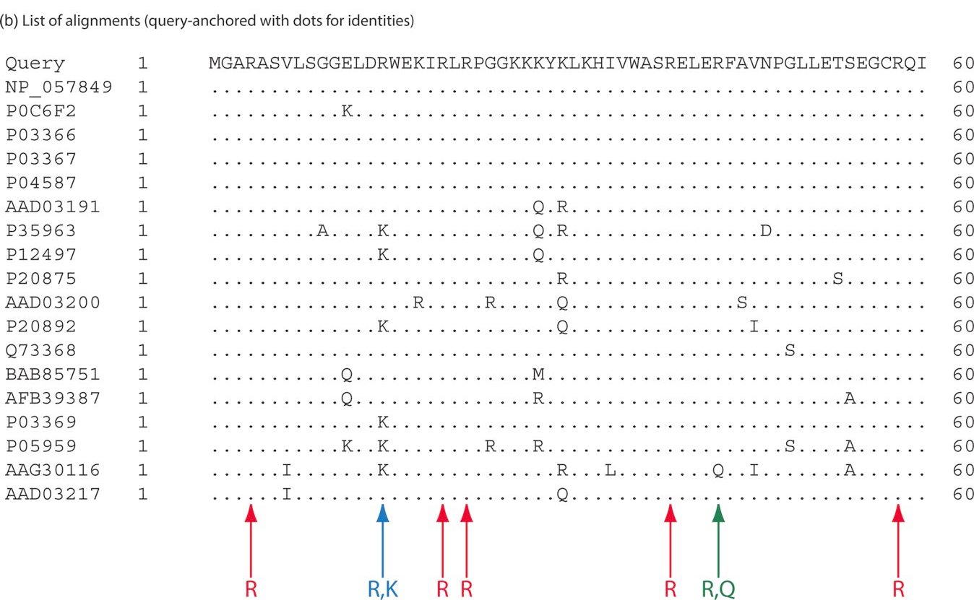
HIV1-Pol Search and Alignments; MSA example and conservation down a column is a good example of how PSSM gathers information as cycles through
Figure 4.19 from the Book
Pevnser, III Ed

Slide 21
PSSM
Query of length L
PSSM will L x 20
Rows will be equal to L
Redundant sequences (at least 94% aa identity ) are eliminated to avoid bias
Closely related sequences will not let to bias the process
From the MSA, a unique matrix is created
PSSM

Slide 22
How does a PSSM look like
NCBI has a viewer. Let us get there to view the PSSM
We will derive the matrix later
http://www.ncbi.nlm.nih.gov/Class/Structure/pssm/pssm_viewer.cgi

Slide 23
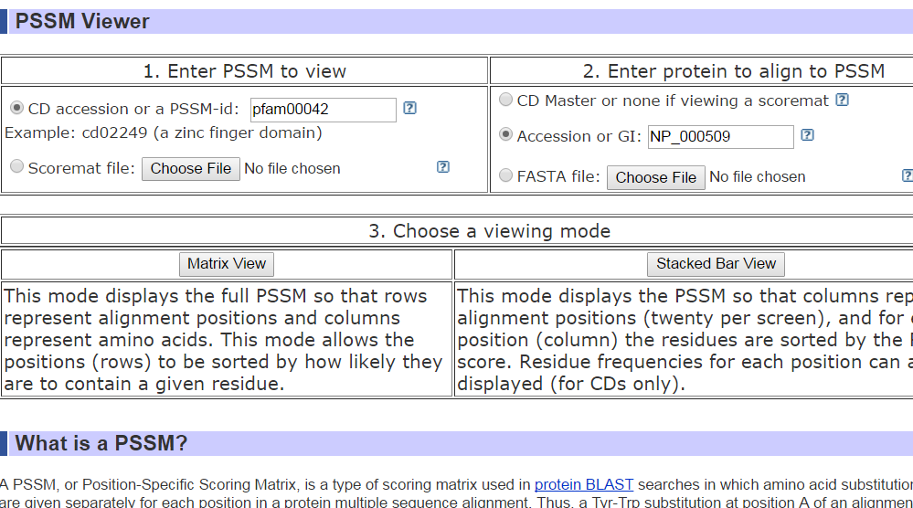
Details
Query of length, L, PSI-BLAST generates PSSM of dimension L x 20
Notes:
http://www.ncbi.nlm.nih.gov/Class/Structure/pssm/pssm_viewer.cgi and enter a PFAM in this case pfam00042 (CDD for globin) and then enter a query, NP_000509

Slide 24
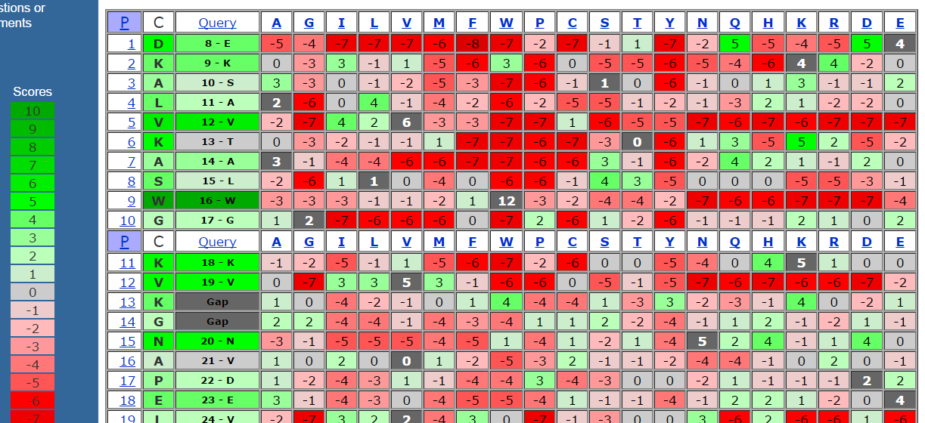
How a query is aligned to a PSSM. Scores are shown (Green for Good and Red for bad)
C: Consensus Sequence
Sliding window was used to get the sequence aligned to the consensus; the one that gets highest score is shown below; Note the scores for a ij substitution is not always the same, but, varies by the column

Slide 25
Also click on the stacked view
Click on the tutorial to see how the scores can be interpreted.

Slide 26
How to create a PSSM
Based on Jim Lund Lecture slides
AA | 1 | 2 | 3 | 4 | 5 | 6 | 7
N | 1 | 0 | 0 | 0 | 0 | 0 | 0
T | 0 | 0.33 | 0.33 | 0 | 0 | 0 | 0
E | 0 | 0 | 0.33 | 0 | 0.66 | 0.33 | 0
G | 0 | 0 | 0 | 0.66 | 0.33 | 0 | 0
W | 0 | 0 | 0 | 0 | 0 | 0.33 | 0.33
I | 0 | 0.66 | 0 | 0 | 0 | 0 | 0.33
H | 0 | 0 | 0 | 0 | 0 | 0 | 0
R | 0 | 0 | 0 | 0.33 | 0 | 0 | 0
A | 0 | 0 | 0.33 | 0 | 0 | 0 | 0
C | 0 | 0 | 0 | 0 | 0 | 0.33 | 0.33
… | … | … | … | … | … | … | …
NTEGEWI NITRGEW
NIAGECC
Frequencies at each position

Slide 27
Pseudo count
Frequency = Frequency of residue I in column j
Frequency will be correct if we collect lots of sequences
So, if a letter is missing from our sequence, there is no guarantee that the frequency of the sequence is zero.
“it assigns minimal scores to resides that are not seen at a certain position in the alignment using the following equation:

Slide 28
NTEGEWI NITRGEW
NIAGECC
Let us try with no pseudocount
Score(N) at position1 is 3/3 = 1
Score(I) at position1 is 1 = 0/3 = 0
Using pseudo counts ( = 1)
Score(N) at position1 = (3+1)/(3+20) = 0.174
Score(I) at position1 = (0+1)/(3+20) = 0.044
PSSM is computed using log scale

Slide 29
The last piece we need is background frequencies (Usually from large scale data)
In this case we are going to assume equal Freq (1/20= 0.05 for every aa )
PSSM score (I) at position1 = log(0.044/0.05) = -0.061
PSSM score (N) at position1 = log(0.174/0.05) = 0.541

Slide 30
PSSM Matrix
AA | 1 | 2 | 3 | 4 | 5 | 6 | 7
N | 0.541 | -0.061 | -0.061 | -0.061 | -0.061 | -0.061 | -0.061
T | -0.061 | 0.240 | 0.240 | -0.061 | -0.061 | -0.061 | -0.061
E | -0.061 | -0.061 | 0.240 | -0.061 | 0.416 | 0.240 | -0.061
G | -0.061 | -0.061 | -0.061 | 0.416 | 0.240 | -0.061 | -0.061
W | -0.061 | -0.061 | -0.061 | -0.061 | -0.061 | 0.240 | 0.240
I | -0.061 | 0.416 | 0.416 | -0.061 | -0.061 | -0.061 | 0.240
H | -0.061 | -0.061 | -0.061 | -0.061 | -0.061 | -0.061 | -0.061
R | -0.061 | -0.061 | -0.061 | 0.240 | -0.061 | -0.061 | -0.061
A | -0.061 | -0.061 | 0.240 | -0.061 | -0.061 | -0.061 | -0.061
C | -0.061 | -0.061 | -0.061 | -0.061 | -0.061 | 0.240 | 0.240
… | … | … | … | … | … | … | …

Slide 31
PSI-BLAST
Using an example

Slide 32
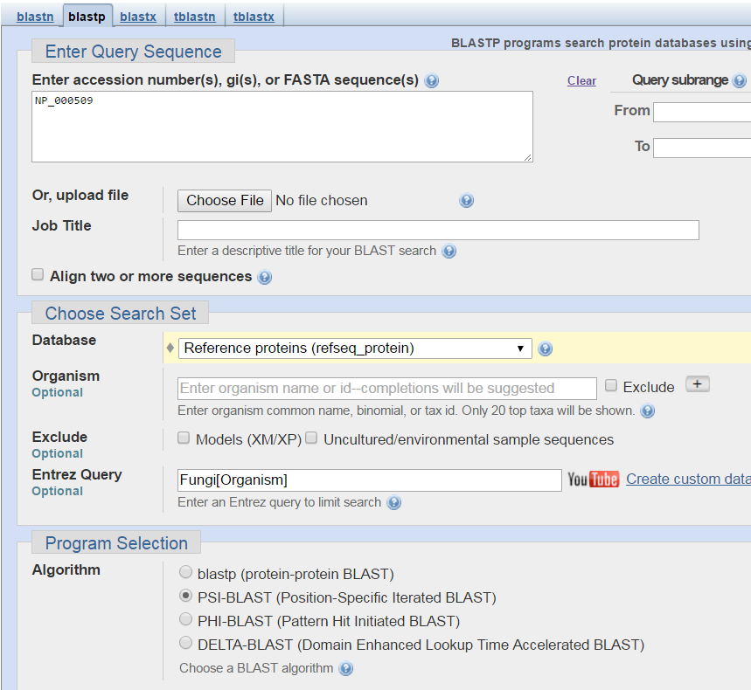
Restricted to only Fungi

Slide 33
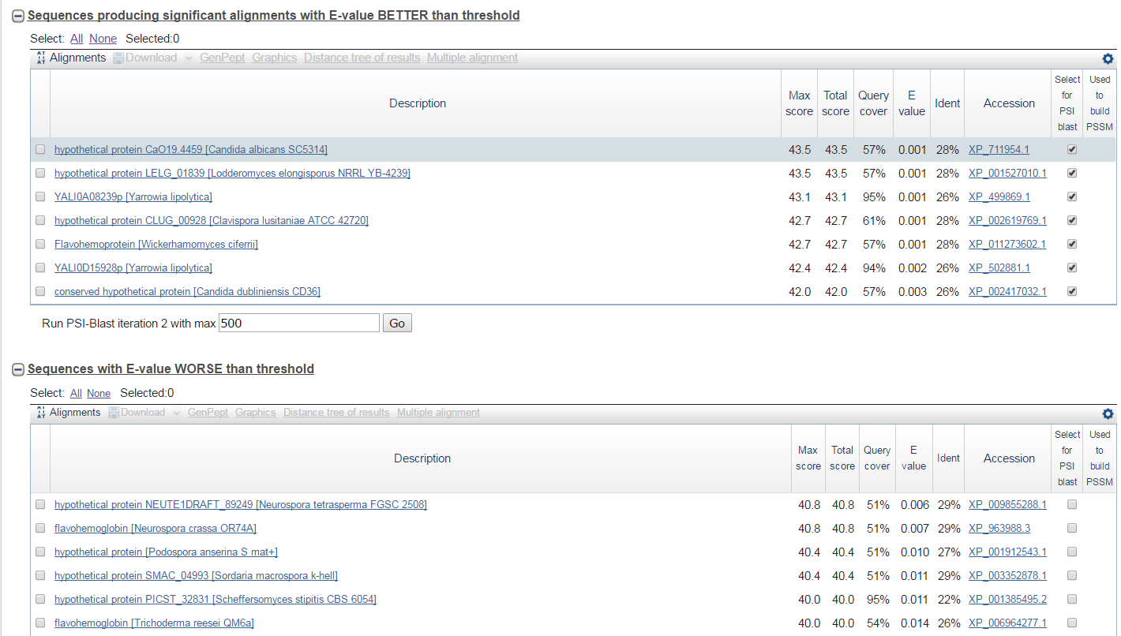
How do we know these are homologs?
3D structure and related biological function;
Most are True Negatives
Better than Threshold you see a genuine homolog Flavohemoproteins Worse than threshold Bacterial hemoglobin

Slide 34
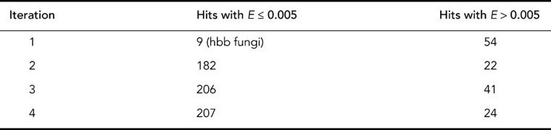
As you continue the PSI-BLAST cycles you will see that the homologs will raise up
NP_000509 PSI-BLAST RefSeq DB restricted to fungi(txid:4751)
After many cycles, 200 different DB matches will be identified. Many are distantly related.

Slide 35
PSI-BLAST
After 5 round, in this case, you see that PSI-BLAST couldn’t find any new within the cutoff

Slide 36
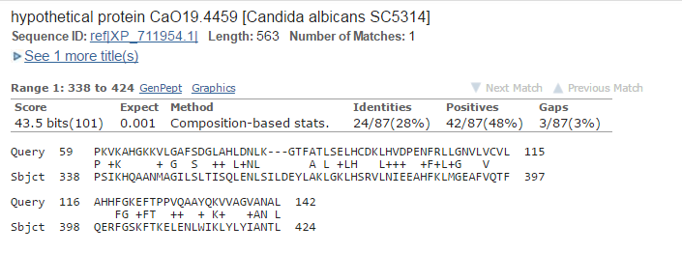
PSI-BLAST by an example
Number 1 hit in the first cycle.
We will view screen-shots of how human beta globin searched using psi-blast to find distantly related globin, C.albicans globin, XP_711954 NOTE: WHEN YOU REPEAT, YOU WILL SEE SLIGHTLY DIFFERENT RESULTS
C.albicans: dimorphic fungus that grows both as yeast and filamentous cells

Slide 37
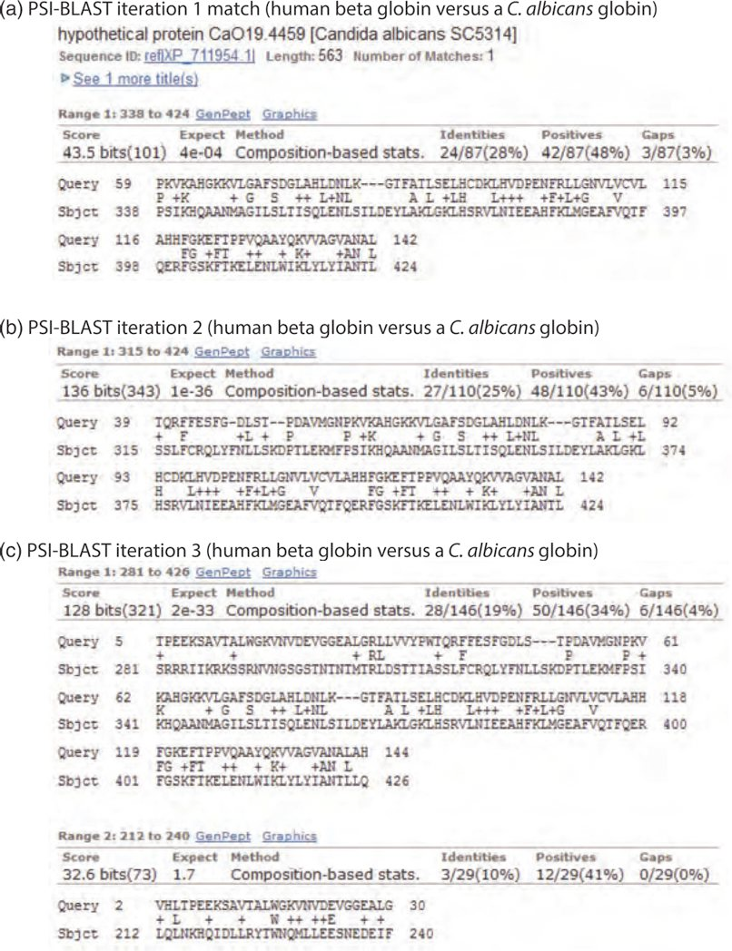
PSI-BLAST by an example
Distantly related Globin, C.albicans
Annotated as hypothetical protein
Length of the alignment grows as cycle progresses

Slide 38
PSI-BLAST by an example
Length of the alignment grows as cycle progresses and the E value drops

Slide 39
Sensitivity of PSI-BLAST

Slide 40
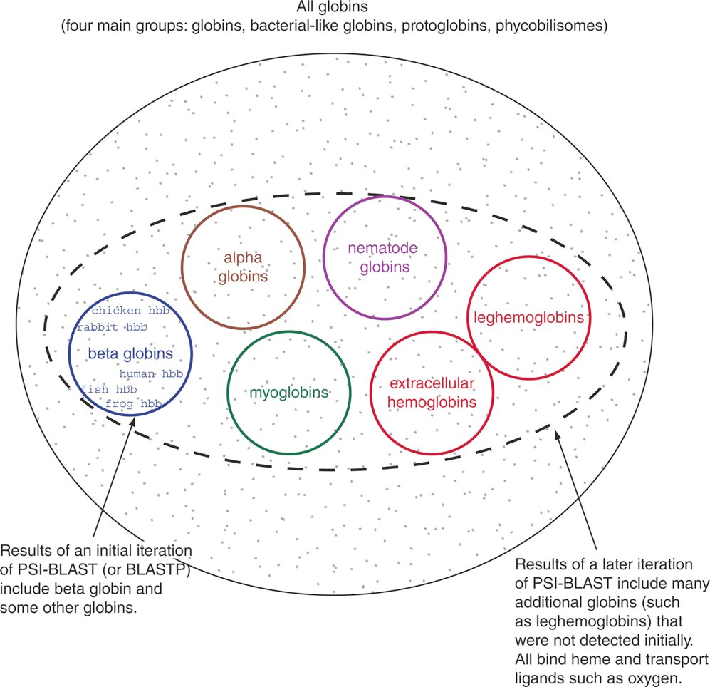

Slide 41
Errors in PSI-Blast
If an unrelated sequence is selected (user or by program in the first round), they will be used to create PSSM and hence the II cycle will be impacted in a negative way
Query contains highly biased amino acid composition
This concept is called corruption

Slide 42
PSI Blast errors & corruption
How to avoid corruption?
Apply compositional filters
Lower E-values (0.005 to 0.0001)
Help to avoid false positives but will also impact true hits
Visually inspect each iteration results.
Check or uncheck the hits that are suspicious
Ex query may have coiled-coiled domain, any protein sharing this domain (ex myosin) will get a high score but clearly not homologous

Slide 43
Reverse Position-specific BLAST
NCBI tool
You can use your query to search against a database of predefined PSSMs
RPS BLAST searches are implemented in CDD
Main job is to identify conserved domains in the query

Slide 44
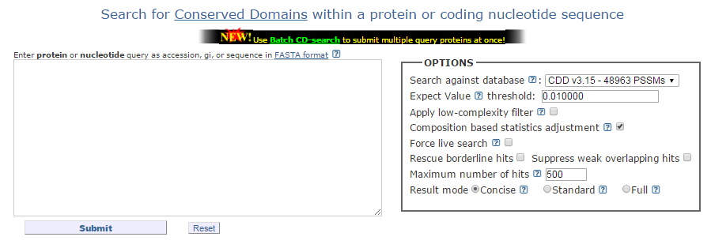
http://www.ncbi.nlm.nih.gov/Structure/cdd/wrpsb.cgi
Search using NP_000509

Slide 45
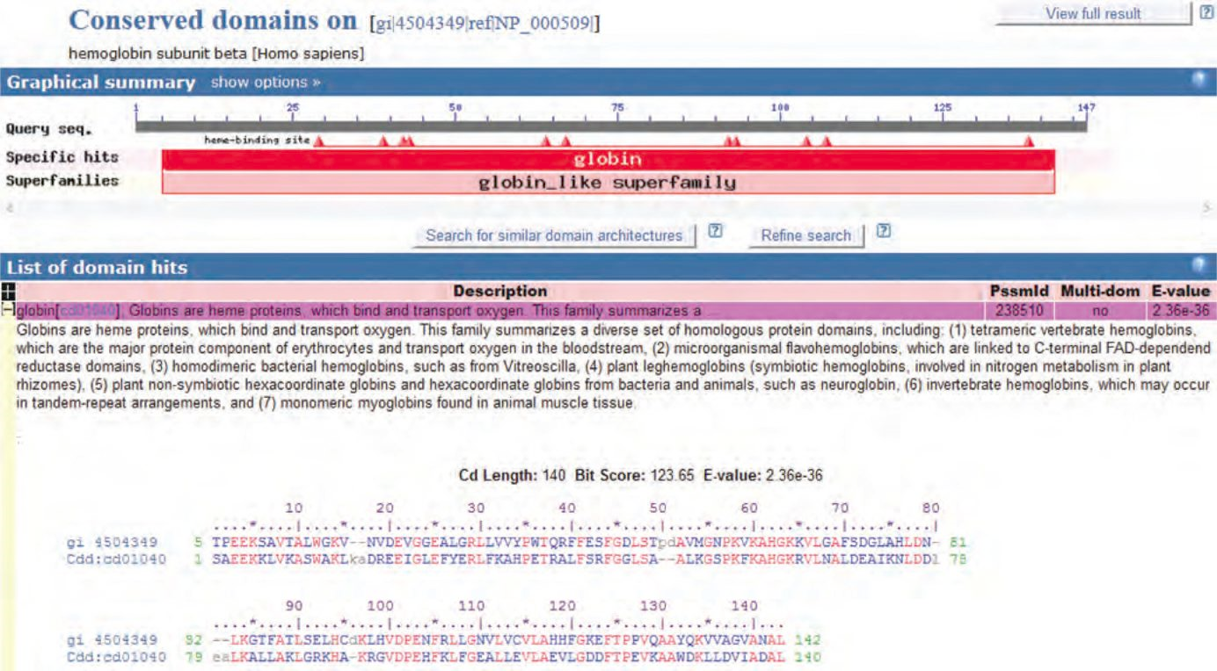
Expand on the dotted circle area to see the alignment

Slide 46
PSI-BLAST and RPS-BLAST
With these tools, we can now introduce most sensitive search tool in NCBI, DELTA-BLAST

Slide 47
DELTA-BLAST
Domain enhanced lookup time accelerated BLAST
Most accurate tool than usual BLAST
How is it different?
Query is searched using pre-created PSSM
Basically this first step is a RPS-BLAST (CDD database)
Use the resulting PSSM to search against protein Database

Slide 48
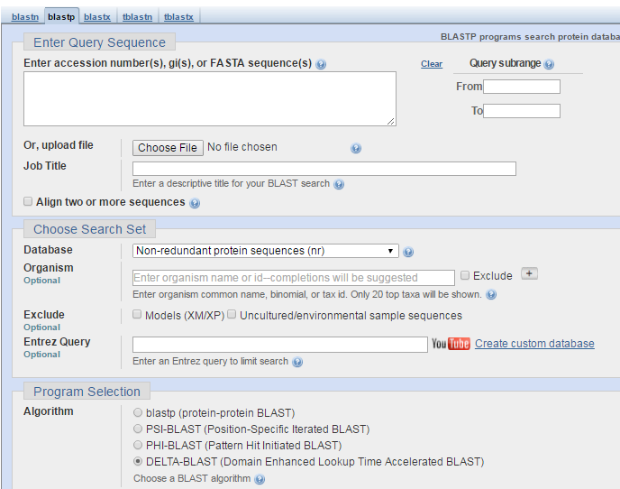
Delta-BLAST
You can start from the BLASTP
Page. This occurs as an additional option all the way at the bottom

Slide 49
Compare NP_000509.1 using BLASTP vs Delta-BLAST
Use RefSeq as the DB
Remaining options default
Do you see the more divergent globins neuroglobin and myoglobin ?
Explore them after the lecture
Also use beta globin as the query to search against plant RefSeq Protein

Slide 50
DELTA-BLAST Advantages
Larger, more complete PSSMs than PSI-BLAST
Why: well-curated DB
More sensitive
More distant homologs then PSI-BLAST
Better quality alignments
Cons
Performance declines with multiple iterations

Slide 51
Comparison
Query: NP_000509.1
Delta-Blast
DB Human RefSeq
Results
Homologs with low E-values with more distant neuroglobin and myoglobin
PSI-Blast
DB: Human RefSeq
Results
Homologs low E values

Slide 52
To do
Human Globin as query
Search Plant Refseq proteins (PSI-BLAST)
Do you see leghemoglobin from barrel medic Medicago truncatula (What is the E-value?)
Repeat with DELTA-BLAST
What do you find?

Slide 53
Comparing the Performance of PSI/DELTA-BLAST
One can use SCOP or ASTRAL database and find distance homologs and use that as a gold standard to search the two methods
ASTRAL
http://scop.berkeley.edu/
http://scop.mrc-lmb.cam.ac.uk/

Slide 54
PHI-BLAST
Pattern-Hit Initiated BLAST
If your query contains a signature of amino acids that define the family.
Ex GXW (lipocalcin family signature; X: any residue)
Pros
Very useful to find distant homologs using the signature
Cons:
short query; lots of false positives

Slide 55
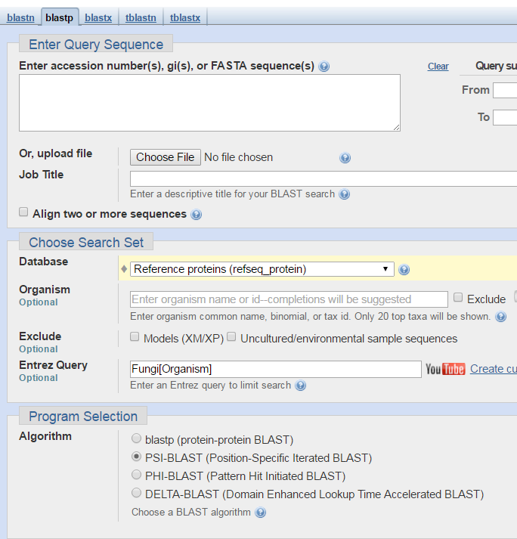

Slide 56
How to choose a pattern
PHI-BLAST
Query Human RBP4; NP_006735
DB: Bacteria
Results
Create multiple alignment
Removed from NCBI The sequence YP_003021245 is 100% identical to WP_015836738.1 over its full length.
WP_010388720 WP_008992866 YP_003021245 NP_006735 WP_015836738.1 NP_006735 WP_010388720 WP_008992866 WP_015836738.1

Slide 57
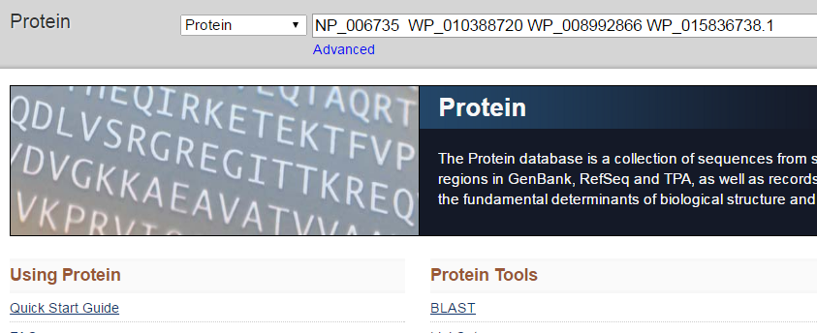
I am showing only 4 sequences for simplicity. You should include all 9 (or 8) sequences. One sequence is identical to another sequence (see previous page)
NP_006735 WP_010388720 WP_008992866 WP_015836738.1

Slide 58
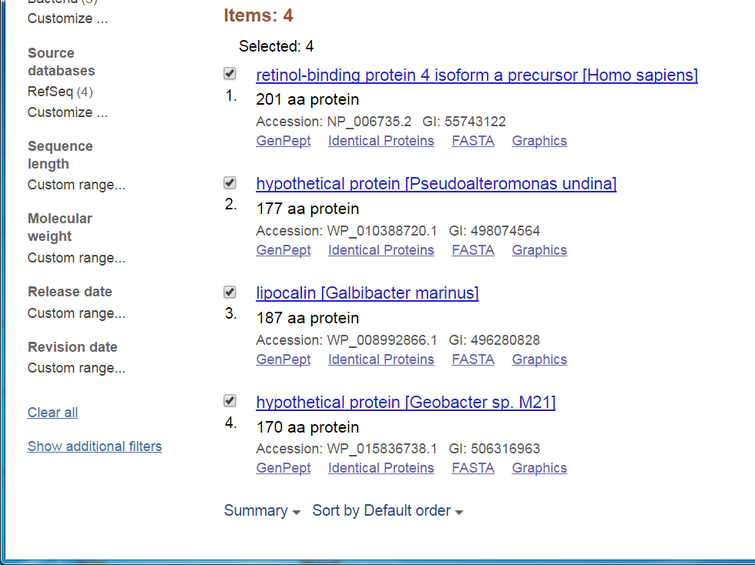

Slide 59
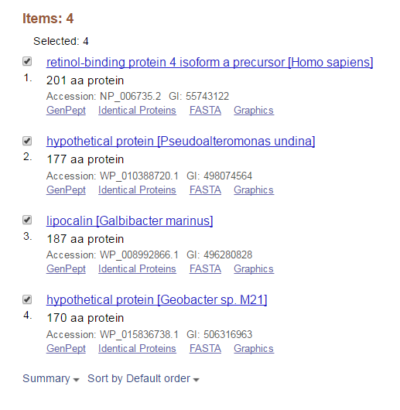
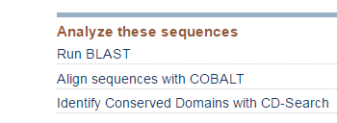
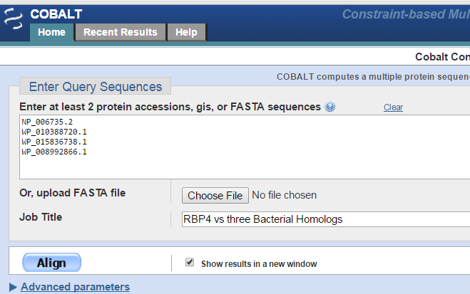

Slide 60
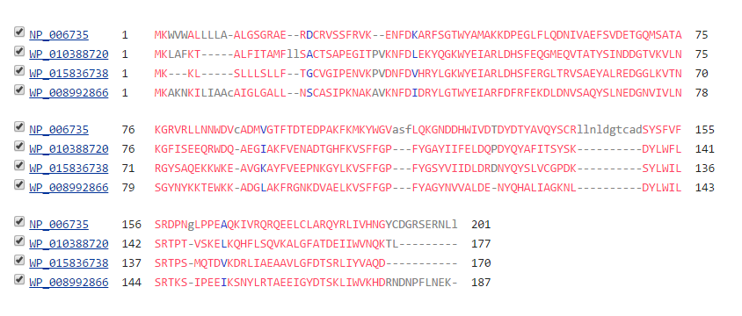
Book uses a different MSA method
NFDX(5)GXW[YF]

Slide 61
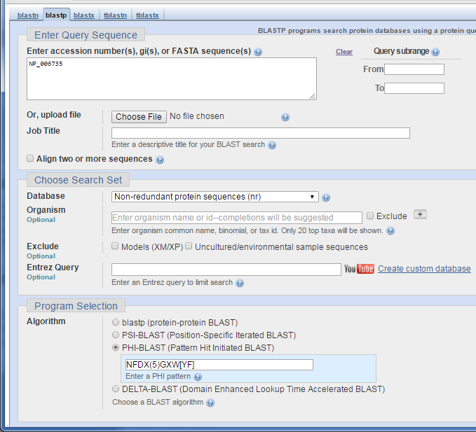

Slide 62
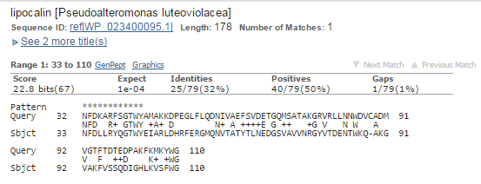
After the first hit
Best Hit from PHI-Blast Note: Bacteria Organism was selected
Note the asterisks shows the pattern match
After the first iteration, PSI-BLAST is pursued, which no longer uses PHI blast pattern but instead uses a search-specific PSSM pattern

Slide 63
HMMER using Linux/Mac/CygWin
Easy to install in Mac/Linux. Instructions are also shown in the book.

Slide 64
MegaBlast and Discontinuous MegaBlast
Large DNA queries
Word size 28
Corresponds to the minimal length of an exact match required to initiate an extension
Discontiguous MegaBLAST
Dissimilar sequences (smaller word-size)-more sensitive and obviously slower
Why is it used?
Comparison of diverged sequences (from different organisms)

Slide 65
Profiles
HBA_AILFU/3-18 LSPADKTN
HBA_AILME/3-18 LSPADKTN
HBA_ALCAA/3-18 LSATDKSN
HBA_ALLMI/3-18 LSMEDKSN
HBA_AMBME/4-18 LSGEDKAN
HBA_AMMLE/3-18 LSAADKSN
HBA_ANAPL/3-18 LSAADKTN
HBA_ANAPP/3-18 LSAADKTN
 | 1 | 2 | 3 | 4 | 5 | 6 | 7 | 8
A | 0.0 | 0.0 | 0.6 | 0.5 | 0.0 | 0.0 | 0.1 | 0.0
G | 0.0 | 0.0 | 0.0 | 0.0 | 0.0 | 0.0 | 0.0 | 0.0
D | 0.0 | 0.0 | 0.0 | 0.0 | 1.0 | 0.0 | 0.0 | 0.0
E | 0.0 | 0.0 | 0.1 | 0.2 | 0.0 | 0.0 | 0.0 | 0.0
K | 0.0 | 0.0 | 0.0 | 0.0 | 0.0 | 1.0 | 0.0 | 0.0
L | 1.0 | 0.0 | 0.0 | 0.0 | 0.0 | 0.0 | 0.0 | 0.0
M | 0.0 | 0.0 | 0.1 | 0.0 | 0.0 | 0.0 | 0.0 | 0.0
N | 0.0 | 0.0 | 0.0 | 0.2 | 0.0 | 0.0 | 0.0 | 1.0
P | 0.0 | 0.0 | 0.2 | 0.0 | 0.0 | 0.0 | 0.0 | 0.0
S | 0.0 | 1.0 | 0.0 | 0.0 | 0.0 | 0.0 | 0.3 | 0.0
T | 0.0 | 0.0 | 0.0 | 0.1 | 0.0 | 0.0 | 0.6 | 0.0

Slide 66
Profiles
HBA_AILFU/3-18 LSPADKTN
HBA_AILME/3-18 LSPADKTN
HBA_ALCAA/3-18 LSATDKSN
HBA_ALLMI/3-18 LSMEDKSN
HBA_AMBME/4-18 LSGEDKAN
HBA_AMMLE/3-18 LSAADKSN
HBA_ANAPL/3-18 LSAADKTN
HBA_ANAPP/3-18 LSAADKTN
 | 1 | 2 | 3 | 4 | 5 | 6 | 7 | 8
A | 0.0 | 0.0 | 0.6 | 0.5 | 0.0 | 0.0 | 0.1 | 0.0
G | 0.0 | 0.0 | 0.0 | 0.0 | 0.0 | 0.0 | 0.0 | 0.0
D | 0.0 | 0.0 | 0.0 | 0.0 | 1.0 | 0.0 | 0.0 | 0.0
E | 0.0 | 0.0 | 0.1 | 0.2 | 0.0 | 0.0 | 0.0 | 0.0
K | 0.0 | 0.0 | 0.0 | 0.0 | 0.0 | 1.0 | 0.0 | 0.0
L | 1.0 | 0.0 | 0.0 | 0.0 | 0.0 | 0.0 | 0.0 | 0.0
M | 0.0 | 0.0 | 0.1 | 0.0 | 0.0 | 0.0 | 0.0 | 0.0
N | 0.0 | 0.0 | 0.0 | 0.2 | 0.0 | 0.0 | 0.0 | 1.0
P | 0.0 | 0.0 | 0.2 | 0.0 | 0.0 | 0.0 | 0.0 | 0.0
S | 0.0 | 1.0 | 0.0 | 0.0 | 0.0 | 0.0 | 0.3 | 0.0
T | 0.0 | 0.0 | 0.0 | 0.1 | 0.0 | 0.0 | 0.6 | 0.0
Given a profile (statistical model), probability of a sequence,
LSPADKTN is (1.0 * 1.0 * 0.2 * 0.5 * 1.0 * 1.0 * 0.6 * 1.0) = 0.06
Score for this sequence is 0.06

Slide 67
Profiles
It is convenient to use log scale (log₂ or log_{e}). One immediate benefit is, one can avoid multiplication and get away by addition (overflow and underflow etc-Computers)
LSPADKTN probability of this sequence is 1.0 * 1.0 * 0.2 * 0.5 * 1.0 * 1.0 * 0.6 * 1.0 = 0.06
Score for this sequence is 0.06
In the loge scale
5*log_{e}(1.0) + log_{e}(0.2) + log_{e}(0.5) + log_{e}(0.6) = -2.813
Note that this is a simple model. Insertions/deletions are not taken into account. Often more complicated rules are used to create a powerful profile model unfortunately sometimes trial and error approach is also followed. This led to the next key development, HMM.

Slide 68
What is a HMM?
HMM is useful for creating probabilistic models of sequence (DNA/protein) ‘labeling’ problems
reworded from Dr. Sean Eddy’s lectures/papers
For example a model to identify introns and exons

Slide 69
HMM
Basics
Markov chain
“Data structure that consists of a computational model with a start state, a finite, discrete set of possible states and a transition function that describes how to move from state to next”

Slide 70
HMM
Based on Anders Krogh, Chapter on HMM
ACA---ATG
TCAACTATC ACAC--AGC
AGA---ATC
ACCG--ATC
Regular Expression
[AT][CG][AC][ACGT]*[A[TG][GC]
* Means [A or C or G or T] any number of times
3 out of 5 have varying gaps after position 3, so prob, 0.6 ACA---ATG
TCAACTATC ACAC--AGC
AGA---ATC
ACCG--ATC
0.4
INS region: 1A, 2C,1T,1G Prob 0.2, 0.4,0.2,0.2
A 0.2 T 0.2
G 0.2
C 0.4
2/5 continued transitions = 0.4
State emission prob.
0.6
0.6
A 0.8 T 0.2
G
C
1.0
A T
G 0.2
C 0.8
1.0
A 0.8 T
G
C 0.2
0.4
A 1.0 T
G
C
1.0
A T 0.8
G
C 0.2
1.0
A T
G 0.2
C 0.8
Notes:
When we visit a state, we emit a Letter (A/T/G/C) with a state’s emission probability. Then, we choose to visit the state with the transisition prob. Distribution

Slide 71
HMM
Goal of many gene model projects
Labelling each residue
States: Exonic (E), Intronic(I), Splice(5’SS), Splice(3’SS)
Let us look at all the ?
Splice-site, codon bias, OR and scoring, Parameter identification etc, What about probability?

Slide 72
Regular Expression
Let us start with the Regular Expression
Based on Anders Krogh, Chapter on HMM
ACA---ATG
TCAACTATC ACAC--AGC
AGA---ATC
ACCG--ATC
Regular Expression
[AT][CG][AC][ACGT]*[A[TG][GC]
* Means [A or C or G or T] any number of times
0.4
A 0.2 T 0.2
G 0.2
C 0.4
0.6
0.6
A 0.8 T 0.2
G
C
1.0
A T
G 0.2
C 0.8
1.0
A 0.8 T
G
C 0.2
1.0
A 1.0 T
G
C
1.0
A T 0.8
G
C 0.2
1.0
A T
G 0.2
C 0.8

Slide 73
HMM
Based on Anders Krogh, Chapter on HMM
From the model, let us calculate the probability of a sequence ACACATC A C A C A T C = 0.8 x 1.0 * 0.8 x 1.0 * 0.8 x 0.6 * 0.4 x 0.6 * 1.0 x 1.0 * 0.8 x 1.0 * 0.8 x 1.0 = 4.7 x 10⁻²
0.4
ACA---ATG
TCAACTATC ACAC--AGC
AGA---ATC
ACCG--ATC
A 0.2 T 0.2
G 0.2
C 0.4
0.6
0.6
A 0.8 T 0.2
G
C
1.0
A T
G 0.2
C 0.8
1.0
A 0.8 T
G
C 0.2
1.0
A 1.0 T
G
C
1.0
A T 0.8
G
C 0.2
1.0
A T
G 0.2
C 0.8

Slide 74
HMM
ACA---ATG
TCAACTATC ACAC--AGC
AGA---ATC
ACCG--ATC
Sequences Prob*100 Log Odds ACAC--ATC 4.7 6.7 ACA---ATG 3.3 4.0 TCAACTATC 0.0075 3.0 ACAC--AGC 1.2 5.3 AGA---ATC 3.3 4.9 ACCG--ATC 0.59 4.6 TGCT--AGG 0.0023 -0.97
Consenses sequence
sequences
Non-consensus Sequence
Couple of issues with probability based scoring:
Score depends on the length of the sequence. Log Odds score is preferred.

Slide 75
HMM Odds Score
NM: Null Model RS_L: Random Sequence of length L OS: Odds Score ; log_{e}: Natural Logarithm
In our case, A,G,C,T are the possibilities, so the random sequence prob is 0.25^{L}

Slide 76
HMM
ACA---ATG
TCAACTATC ACAC--AGC
AGA---ATC
ACCG--ATC
Odds = Ratio of two hypotheses = HMM Model/Null Model =
Sequences Prob*100 Log Odds ACAC--ATC 4.7 6.7 ACA---ATG 3.3 4.0 TCAACTATC 0.0075 3.0 ACAC--AGC 1.2 5.3 AGA---ATC 3.3 4.9 ACCG--ATC 0.59 4.6 TGCT--AGG 0.0023 -0.97
Consensus sequence
sequences
Non-consensus Sequence
Notice that when the sequence fits the model/motif, the log odds score is high and look at the last sequence. Notice that it fits the motif of random sequence, so its Odds Score is negative

Slide 77
HMM updated using Log Odds Score
Ods Score
ACAC--ATC 6.7
Probabilities are turned into log odds
Transition probabilities are converted into log values
Note that you can simply read off the numbers and add them
1.16 + 0.00 + 1.16 + 0.00
+ 1.16 - 0.51 + 0.40 - 0.51
+ 1.39 + 0.0 + 1.16 + 0.0 1.16
-0.92
A -0.22 T -0.22
G -0.22
C 0.47
-0.51
-0.51
0.0
0.0
0.0
0.0
0.0
A 1.16 T -0.22
G -0.22
C 1.16
A 1.16
C -0.22
T 1.16
C -0.22
G -0.22
C 1.16
A 1.39

Slide 78
HMM
Other possibilities for Null model
One can consider using all the sequences for an organism of interest
Example look into the UniProt if the model is for protein sequences

Slide 79
After the talk
Self-Test Quiz
Problems/Computer Lab
5-1, 5.3 and 5-6

Slide 80
Extra

Slide 81
Sample Problem
Given a DNA Sequence with the following information
Segment info:
Exon-intron
Exons: Uniform (A,T,G,C composition (25%) on <>)
Introns (mostly made up of A/T (40%/40%))
G/C (10%/10%)
5’SS is mostly G
5’
Exon
Intron
3’
5’SS nt is 95% G and 5% A
Based on many Sean R. Eddy’s lectures and papers

Slide 82
A = 0.05, G = 0.95, T = C = 0.00
A = C = T = G = 0.25
A = T = 0.4, C = G = 0.1
E
5’
I
1.0
0.1
1.0
0.1
Start
End
0.9
0.9
Transition Probabilities (describe how the transition behavior; many Es → one 5’ → I )
Emission Probabilities

Slide 83
How does this work?
Visit a state (E,I or 5’S), we emit a residue (a Nucleotide)
according to the emission probability
A = 0.25, C = 0.25, T=0.25, G = 0.25
Decide on state’s transition probability
Decide what state to visit next according to the transition prob.

Slide 84
Thanks
Ravichandran@hood.edu

